Slide 1


Introduction to Natural Language Processing
Manish Shrivastava

Slide 2
Outline
Logistics
Overview
Projects
Discussion

Slide 3


Logistics
Fast-paced, Hands-on
From basics to State-of-the-art
Quiz, Assignments, Projects
Timing 10:00 Monday Thursday
https://intranet.iiit.ac.in/offices/static/files/Lecturetimetable-Spring2023-V2.pdf

Slide 4
Weightages
Assignments: 20%
Mid Evaluation (written): 10 %
Project: 40%
End Evaluation (Written): 20%
Quiz: 10%

Slide 5
Course Objectives
Demonstrate the knowledge of stages and fundamental building blocks of NLP
Apply NLP machine learning algorithms for classification, representation, and parsing
Demonstrate the knowledge of Dense vector representation for NLP
Explain the concepts behind distributed semantics
Discuss the approaches to global and contextual semantic representation
Apply the above concepts for fundamental NLP tasks.

Slide 6
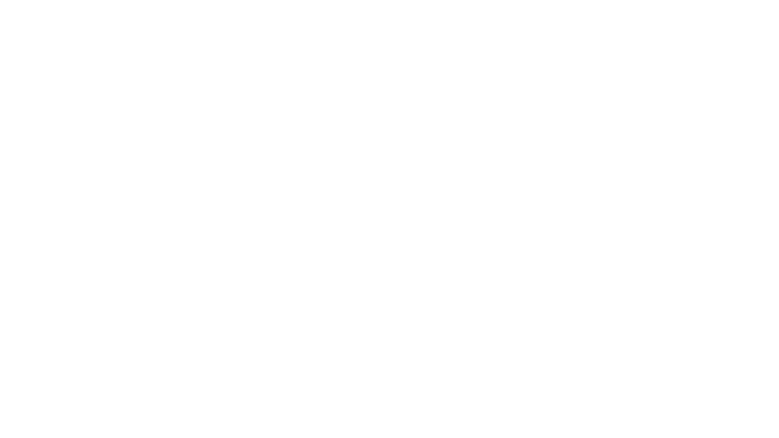

Why NLP?
Ubiquitous!!
Multi-faceted
Need of the hour
Unsolved ☺

Slide 7
Syllabus
Unit 1: Stages of NLP: from lexical to semantic. Fundamental Language processing : Tokenization, Language modeling, Text classification,
Unit 2: Morphology, POS Tagging, Chunking, Discriminative vs generative modes, HMM and CRF
Unit 3: Syntax parsing: Constituency and Dependency, PCFG, projectivity Arc-eager
Unit 4: Distributed semantics: SVD, Word2Vec, RNN, LSTM,
Unit 5: Contextual Distributed semantics: ElMO, BERT

Slide 8
Introduction to NLP
Manish Shrivastava

Slide 9
What is NLP?
Also called Computational Linguistics
Not really the same
Processing of Language Content
Text and Speech
Identifying language phenomena (grammar etc.)
Understanding language content (meaning, intent, sentiment etc.)

Slide 10
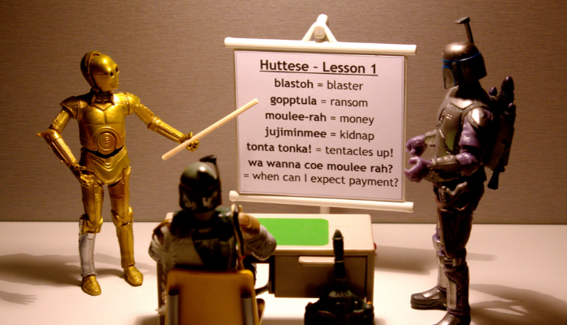
What is NLP
Wiki: Natural language processing (NLP) is a field of computer science, artificial intelligence, and computational linguistics concerned with the interactions between computers and human (natural) languages.

Slide 11
Go beyond the keyword matching
Identify the structure and meaning of words, sentences, texts and conversations
Deep understanding of broad language
NLP is all around us

Slide 12
Two Generations of NLP
Hand-crafted Systems – Knowledge Engineering [1950s– ]
Rules written by hand; adjusted by error analysis
Require experts who understand both the systems
and domain
Iterative guess-test-tweak-repeat cycle
Automatic, Trainable (Machine Learning) System [1985s– ]
The tasks are modeled in a statistical way
More robust techniques based on rich annotations
Perform better than rules (Parsing 90% vs. 75% accuracy)
Unsupervised semantics [2011-]
Deep Learning

Slide 13
NLP
Computers use (analyze, understand, generate) natural language
Text Processing
Lexical: tokenization, part of speech, head, lemmas
Parsing and chunking
Semantic tagging: semantic role, word sense
Certain expressions: named entities
Discourse: coreference, discourse segments
Speech Processing
Phonetic transcription
Segmentation (punctuations)
Prosody

Slide 14

Trends
An enormous amount of knowledge is now available in machine readable form as natural language text
Conversational agents are becoming an important form of human-computer communication
Much of human-human communication is now mediated by computers

Slide 15
Major levels
Words
Syntax
Meaning
Discourse
5. Applications exploiting each

Slide 16
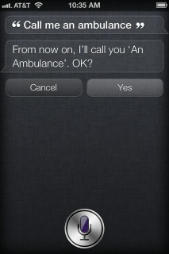
Challenges – ambiguity
Word sense / meaning ambiguity
Credit: http://stuffsirisaid.com

Slide 17
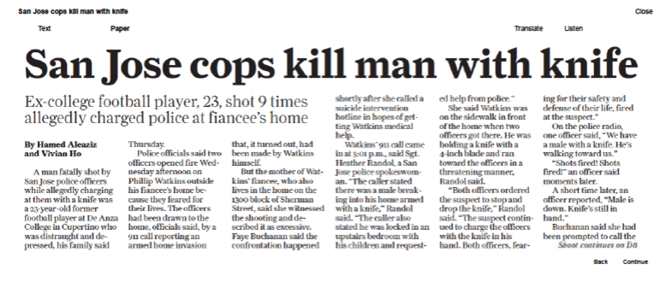
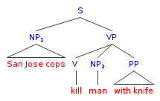
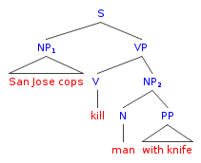
Challenges – ambiguity
PP attachment ambiguity
Credit: Mark Liberman, http://languagelog.ldc.upenn.edu/nll/?p=17711

Slide 18
Challenges -- ambiguity
Ambiguous headlines:
Include your children when baking cookies
Local High School Dropouts Cut in Half
Hospitals are Sued by 7 Foot Doctors
Iraqi Head Seeks Arms
Safety Experts Say School Bus Passengers Should Be Belted
Teacher Strikes Idle Kids

Slide 19
Challenges – scale
Examples:
Bible (King James version): ~700K
Penn Tree bank ~1M from Wall street journal
Newswire collection: 500M+
Wikipedia: 2.9 billion word (English)
Web: several billions of words

Slide 20
The Steps in NLP

Slide 21
What we do in this course
Objective: To get the student ready to have a fair understanding of the
Challenges
Tasks
Techniques
philosophies

Slide 22
Focus
Textual NLP
Address each level and tasks therein
Identify areas of interest and build the groundwork

Slide 23
Tokenization
The task of separating ‘Tokens’ in a given input sentence
Example
“This is my brother’s cat”
Should be
“ This is my brother’s cat ”
Or should it be
“ This is my brother ‘ s cat ”

Slide 24
Terms
Token : a ‘Token’ is a single surface form word
Example :
My cat is afraid of other cats .
Here, ‘cat’ and ‘cats’ are both tokens
Giving a total of 8 tokens in the above sentence
‘ . ’ or any punctuation mark is counted as a token

Slide 25
Terms
Type : Type is a vocabulary word
A word which might be present in its root form in the dictionary
‘cat’ is the type for both ‘cat’ and ‘cats’
The set of all types is the vocabulary of a language
Ques: What would a high token to type ratio tell you about a language ?

Slide 26
Tokenization
Identifying individual tokens in a given input
Types are not of concern at this point
Ques: Is the task of tokenization difficult?
??

Slide 27
Challenges
Hyphenation
I am a hard-working student .
We would deal with the state-of-the-art .
I am not going to sho-
Number
The value of gravity is 9.8 m/s/s
He got 1,000,000 dollars in VC funding .
My number is +918451990342
Take ½ cups of milk
Abbreviation
Dr. S. S. S. P. Rao Was a faculty AT IITB
We are in IIIT-H campus
Dates
My birth date is 03/09/2041
I joined on 22nd July
Punctuations
This, hands-on experience, is rare in pedagogy .
I … uh … not sure how to proceed :-)

Slide 28
Regular Expressions
Each programming language implements slightly differently
Java : Pattern and Matcher classes
C : include <regex.h>
Perl : inbuilt
Python : import re;

Slide 29
N-Grams and Zipf’s Law

Slide 30

Basic Idea:
Examine short sequences of words
How likely is each sequence?
“Markov Assumption” – word is affected only by its “prior local context” (last few words)

Slide 31
Example
The boy ate a chocolate
The girl bought a chocolate
The girl then ate a chocolate
The boy bought a horse
Can we figure out how likely is the following sentence
The boy bought a chocolate

Slide 32
“Shannon Game”
Claude E. Shannon. “Prediction and Entropy of Printed English”, Bell System Technical Journal 30:50-64. 1951.
Predict the next word, given (n-1) previous words
Determine probability of different sequences by examining training corpus

Slide 33
Forming Equivalence Classes (Bins)
“n-gram” = sequence of n words
bigram
trigram
four-gram or quadrigram
Probabilities of n-grams
Unigram
Bigram
Trigram

Slide 34
Maximum Likelihood Estimation
Data
The boy ate a chocolate
The girl bought a chocolate
The girl then ate a chocolate
The boy bought a horse
The boy bought a chocolate
Unigram Probabilities
(4/21)*(2/21)*(2/21)*(4/21)*(3/21)
(4*2*2*4*3)/21^5 = 0.000047
Bi-gram Probabilities
<The boy> <boy bought> <bought a> <a chocolate>
(2/4)*(2/4)*(2/2)*(3/4) = 0.1875

Slide 35
Reliability vs. Discrimination
“large green ___________”
tree? mountain? frog? car?
“swallowed the large green ________”
pill? candy?

Slide 36
Reliability vs. Discrimination
larger n: more information about the context of the specific instance (greater discrimination)
smaller n: more instances in training data, better statistical estimates (more reliability)

Slide 37
Selecting an n Vocabulary (V) = 20,000 words
n | Number of bins
2 (bigrams) | 400,000,000
3 (trigrams) | 8,000,000,000,000
4 (4-grams) | 1.6 x 10¹⁷

Slide 38
Statistical Estimators
Given the observed training data …
How do you develop a model (probability distribution) to predict future events?
Language Modeling
Predict Likelihood of sequences

Slide 39
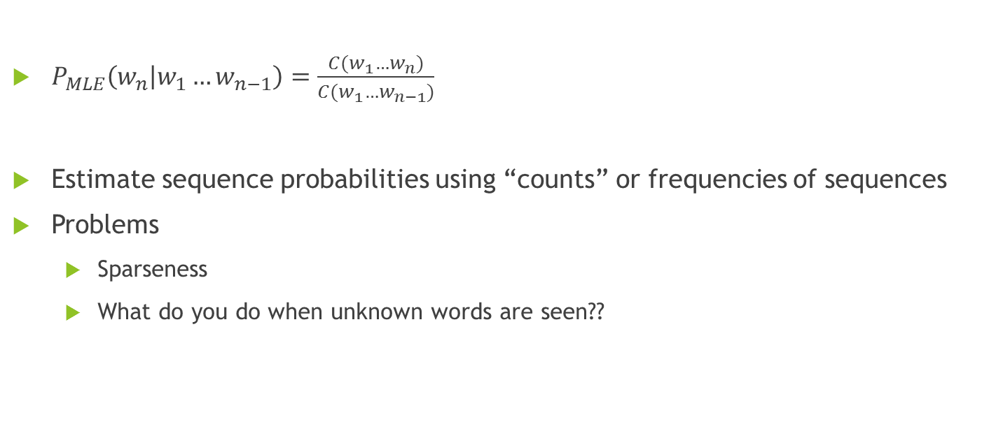
Maximum Likelihood Estimation

Slide 40
Example
Data
The boy ate a chocolate
The girl bought a chocolate
The girl then ate a chocolate
The horse bought a boy
The boy bought a chocolate
Unigram Probabilities
(4/16)*(2/16)*(2/16)*(4/16)*(3/16)
(4*2*2*4*3)/21^5 = 0.000047
Bi-gram Probabilities
<The boy> <boy bought> <bought a> <a chocolate>
(2/4)*(0/4)*(2/2)*(3/4) = 0

Slide 41
Approximating Shakespeare
Generating sentences with random unigrams...
Every enter now severally so, let
Hill he late speaks; or! a more to leg less first you enter
With bigrams...
What means, sir. I confess she? then all sorts, he is trim, captain.
Why dost stand forth thy canopy, forsooth; he is this palpable hit the King Henry.
Trigrams
Sweet prince, Falstaff shall die.
This shall forbid it should be branded, if renown made it empty.

Slide 42
Quadrigrams
What! I will go seek the traitor Gloucester.
Will you not tell me who I am?
What's coming out here looks like Shakespeare because it is Shakespeare
Note: As we increase the value of N, the accuracy of an n-gram model increases, since choice of next word becomes increasingly constrained

Slide 43
N-Gram Training Sensitivity
If we repeated the Shakespeare experiment but trained our n-grams on a Wall Street Journal corpus, what would we get?
Note: This question has major implications for corpus selection or design

Slide 44
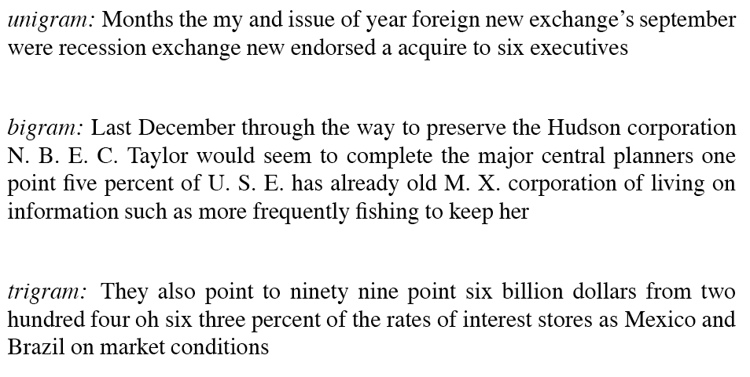
WSJ is not Shakespeare: Sentences Generated from WSJ
Notes:
44

Slide 45
Evaluation and Data Sparsity Questions
Perplexity and entropy: how do you estimate how well your language model fits a corpus once you’re done?
Smoothing and Backoff : how do you handle unseen n-grams?
Notes:
45

Slide 46
Perplexity and Entropy
Information theoretic metrics
Useful in measuring how well a grammar or language model (LM) models a natural language or a corpus
Entropy: With 2 LMs and a corpus, which LM is the better match for the corpus? How much information is there (in e.g. a grammar or LM) about what the next word will be? More is better!
For a random variable X ranging over e.g. bigrams and a probability function p(x), the entropy of X is the expected negative log probability

Slide 47
Entropy is the lower bound on the # of bits it takes to encode information e.g. about bigram likelihood
Perplexity
At each choice point in a grammar
What are the average number of choices that can be made, weighted by their probabilities of occurrence?
I.e., Weighted average branching factor
How much probability does a grammar or language model (LM) assign to the sentences of a corpus, compared to another LM? The more information, the lower perplexity

Slide 48
Some Useful Observations
There are 884,647 tokens, with 29,066 word form types, in an approximately one million word Shakespeare corpus
Shakespeare produced 300,000 bigram types out of 844 million possible bigrams: so, 99.96% of the possible bigrams were never seen (have zero entries in the table)
A small number of events occur with high frequency
A large number of events occur with low frequency
You can quickly collect statistics on the high frequency events
You might have to wait an arbitrarily long time to get valid statistics on low frequency events
Some zeroes in the table are really zeros But others are simply low frequency events you haven't seen yet. How to address?
Notes:
48

Slide 49
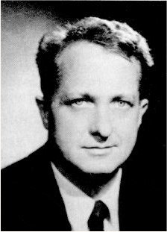
Zipf’s Law
･ Frequency of occurrence of words is inversely proportional to the rank in this frequency of occurrence.
･ When both are plotted on a log scale, the graph is a straight line.

Slide 50
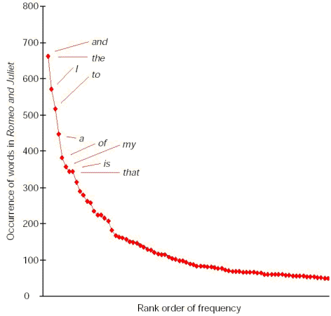
Zipf Distribution
The Important Points:
a few elements occur very frequently
a medium number of elements have medium frequency
many elements occur very infrequently
The product of the frequency of words (f) and their rank (r) is approximately constant

Slide 51
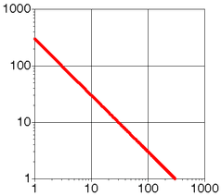
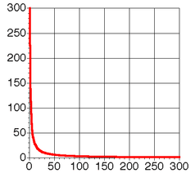
Zipf Distribution (Same curve on log and linear scale)

Slide 52
What Kinds of Data Exhibit a Zipf Distribution?
Words in a text collection
Virtually any language usage
Library book checkout patterns
Incoming Web Page Requests (Nielsen)
Outgoing Web Page Requests (Cunha & Crovella)
Document Size on Web (Cunha & Crovella)

Slide 53
Characteristics of WWW Client-based Traces
Zipf's Law Applied To WWW Documents

Slide 54
Distribution of users among web sites

Slide 55
Binned distribution of users to sites
Exponentially increasing bins
Cumulative distribution of users to sites

Slide 56
Example
Data
The boy ate a chocolate
The girl bought a chocolate
The girl then ate a chocolate
The horse bought a boy
The boy bought a chocolate
Unigram Probabilities
(4/16)*(2/16)*(2/16)*(4/16)*(3/16)
(4*2*2*4*3)/21^5 = 0.000047
Bi-gram Probabilities
<The boy> <boy bought> <bought a> <a chocolate>
(2/4)*(0/4)*(2/2)*(3/4) = 0

Slide 57
Smoothing
Higher order n-grams perform well but suffer from data sparsity
Lower order n-grams are not reliable
Standard MLE does not work for unseen data
Laplace smoothing (add-one)
Lidstone’s law
Held-out Estimation
Good Turing Estimation

Slide 58


Laplace Smoothing
The oldest smoothing method available
Each unseen n-gram is given a very low estimate
$P_{Lap}(w_{1}…w_{n−1}w_{n})=\frac{C\left(w_{1}…w_{n}\right)+1}{N+B}$
Probability 1/(N+B) or Frequency (estimated) N/(N+B)
N is the number of seen n-grams and B is the number of possible n-grams

Slide 59

Lidstone’s Law
The probability mass assigned to unseen events is too high with Laplace smoothing
Solution : assign smaller addition
$P_{Lid}\left(w_{1}…w_{n−1}w_{n}\right)=\frac{C\left(w_{1}…w_{n}\right)+λ}{N+Bλ}$
Jeffereys-Perks law
Set $λ$ as ½
Expectation of $λ$ that maximizes above equation

Slide 60
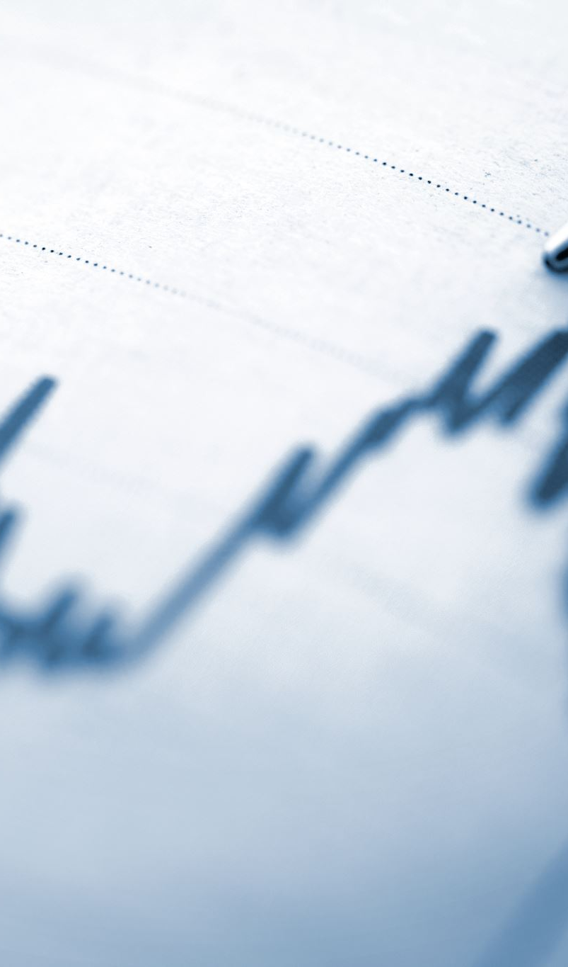
Held Out Estimation
So far, we have not considered how the learned estimates behave in real life
It is possible that the learnt values are just a property of the training data
Imagine training from Chemical domain and applying in Physics domain
Also, adding a random value is not very sound
At higher total count the probability of something that occurred once and something that never occurred would be very close
Adding small value also increases the total denominator.
Bλ might become a very large part of ( N + Bλ )
In other words, a large probability mass might be assigned to unseen events

Slide 61
Held-out estimates
Treat part of the data as “real life” data
Intuition :
Estimates of bigrams with similar frequencies, would be similar
Example: if <a boy> occurs 3 times and <a girl> occurs 3 times, instead of treating them as different, we can consider them to belong to one class or bin ;
Bigrams with frequency 3
Now we can calculate the average probability for all bigrams with frequency 3

Slide 62
Held-Out Estimation
Method:
Partition data into two parts
Training and Held-Out
Nr = Number of n-grams with frequency ‘r’ in Training data
Tr = sum of number of times all the n-grams with frequency r, as identified in the training data, appear in the Held-Out data
Then

Slide 63
Held Out Estimation
Freq | Training Data (number of words with given frequency) | Held Out Data (Sum of Frequencies of words with r freq in Training)
1 | N1 | T1 = (Nr*r*)
2 | N2 | T2
3 | N3 | T3
4 | N4 | T4
.
.
r | Nr (average frequency of these words = Nr*r/Nr = r) | Tr (average frequency of these words = Tr/Nr = r*)
.
.

Slide 64
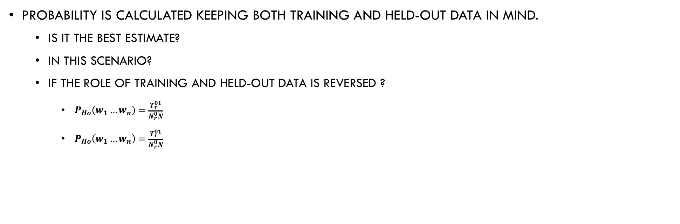
Held-out Estimation
Probability is calculated keeping both training and held-out data in mind.
Is it the best estimate?
In this scenario?
If the role of training and held-out data is reversed ?
$P_{Ho}\left(w_{1}…w_{n}\right)=\frac{T_{r}^{01}}{N_{r}^{0}N}$
$P_{Ho}\left(w_{1}…w_{n}\right)=\frac{T_{r}^{01}}{N_{r}^{0}N}$

Slide 65
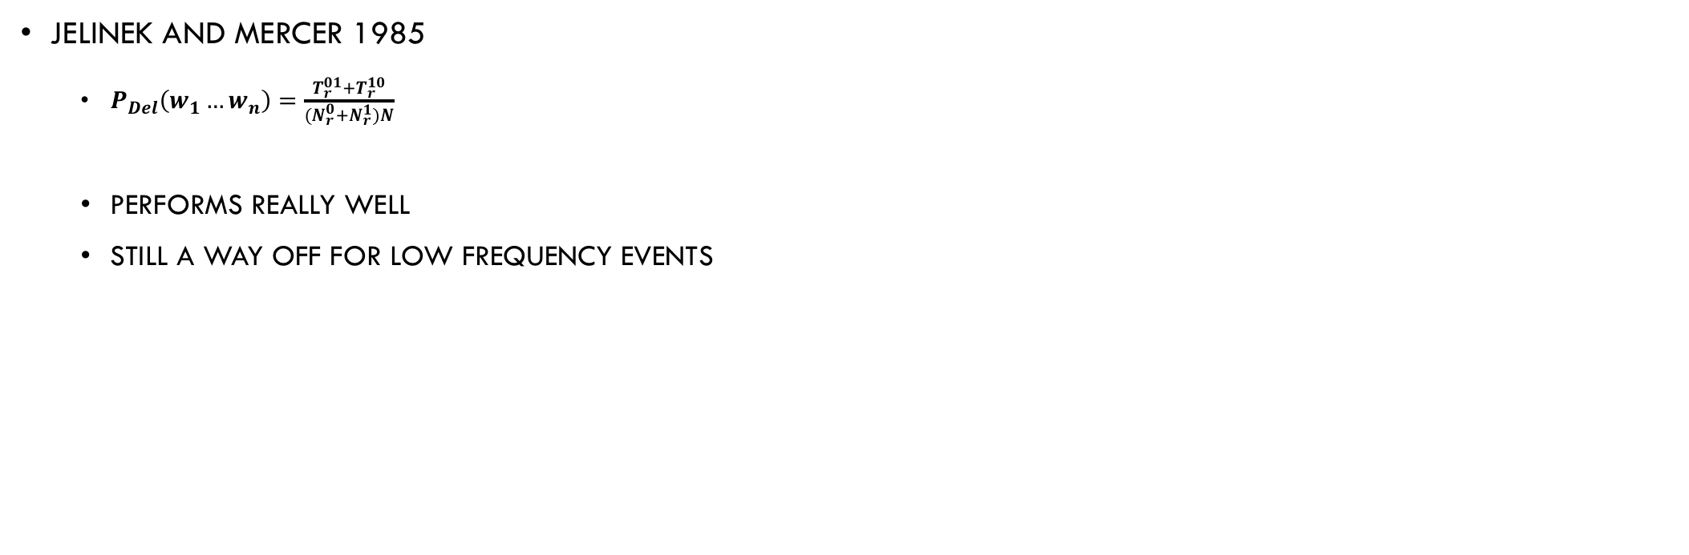
Deleted Estimation (Cross-Estimation)
Jelinek and Mercer 1985
$P_{Del}\left(w_{1}…w_{n}\right)=\frac{T_{r}^{01}+T_{r}^{10}}{{(N}_{r}^{0}{+N}_{r}^{1})N}$
Performs really well
Still a way off for low frequency events

Slide 66
Good Turing Smoothing
Word classes with similar frequency counts can be treated similarly
Or can help each other
A word which is at frequency 1 is a rare word, it is just by chance that you have been able to see it (data property )
We should be able to compute (approximately) probabilities of lower frequency words with the help of higher frequency words
Nr = Number of n-grams with frequency ‘r’ in Training data
Here r* is the adjusted frequency
The probability then is r*/N

Slide 67
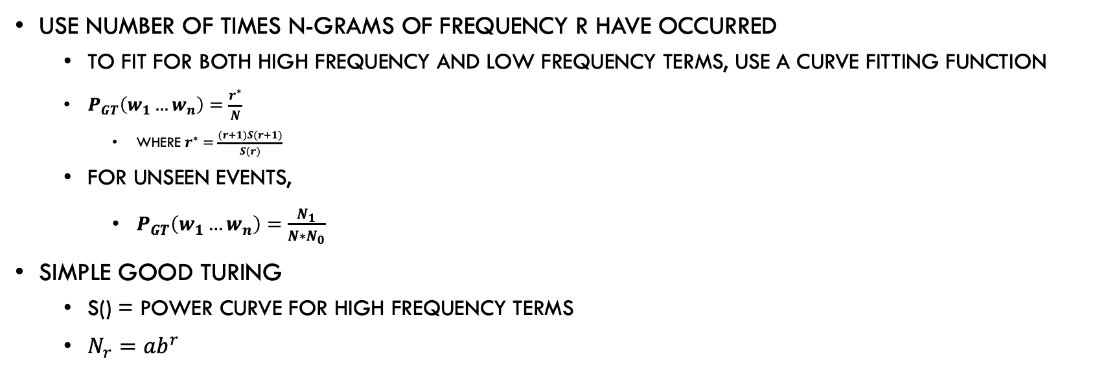
Good-Turing Smoothing
Use Number of times n-grams of frequency r have occurred
To fit for both high frequency and low frequency terms, use a curve fitting function
$P_{GT}\left(w_{1}…w_{n}\right)=\frac{r^{∗}}{N}$
Where $r^{∗}=\frac{(r+1)S(r+1)}{S(r)}$
For unseen events,
$P_{GT}\left(w_{1}…w_{n}\right)=\frac{N_{1}}{N∗N_{0}}$
Simple Good Turing
S() = Power Curve for high frequency terms
$N_{r}=ab^{r}$

Slide 68
Example
Consider the data
I like strong coffee
I bought some coffee
I drank black coffee
Good coffee is strong coffee
Then the test sentence
I like black strong coffee
The trigram <black strong coffee> is never seen before and will be assigned some small probability
But bigram <strong coffee> is seen and is very informative

Slide 69
Back Off
Back off is “using lower order N-grams for estimating higher orders”
Back-Off
Linear Interpolation
Katz Backoff
General linear Interpolation

Slide 70
Back off
So far, all we have done is get estimates for various n-grams
Problems (Same old),
For n-grams with low frequency, estimates are not really good
Solution,
If n-gram does not work, fall back to (n-1)-gram
Better still, combine estimators for n-gram, (n-1)-gram, (n-2)-gram … unigram

Slide 71
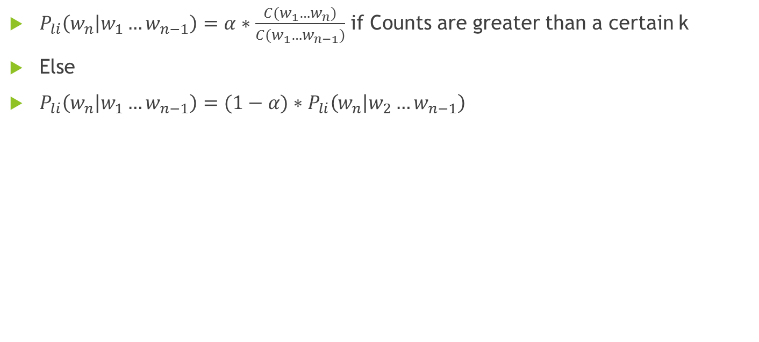
Katz Back-off
$P_{li}\left(w_{n} | w_{1}…w_{n−1}\right)=α∗\frac{C(w_{1}…w_{n})}{C(w_{1}…w_{n−1})}$ if Counts are greater than a certain k
Else
$P_{li}\left(w_{n} | w_{1}…w_{n−1}\right)=(1−α)∗P_{li}\left(w_{n} | w_{2}…w_{n−1}\right)$

Slide 72
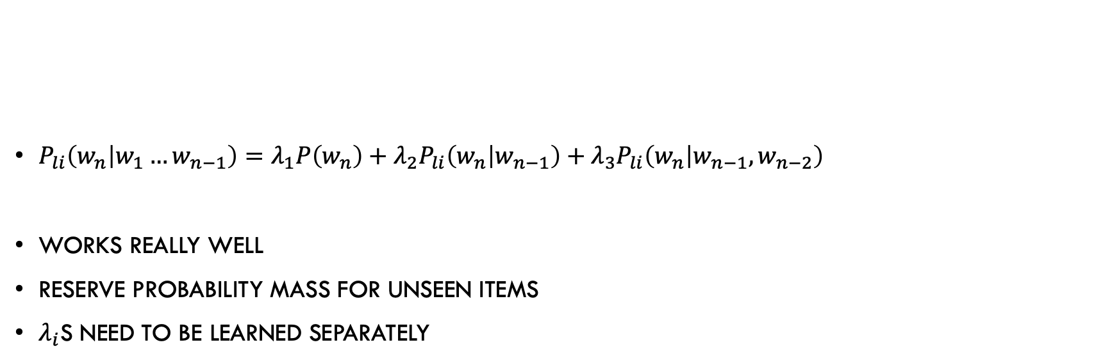
Linear Interpolation
$P_{li}\left(w_{n} | w_{1}…w_{n−1}\right)=λ_{1}P\left(w_{n}\right)+λ_{2}P_{li}\left(w_{n} | w_{n−1}\right)+λ_{3}P_{li}\left(w_{n} | w_{n−1},w_{n−2}\right)$
Works really well
Reserve Probability mass for unseen items
$λ_{i}$s need to be learned separately

Slide 73
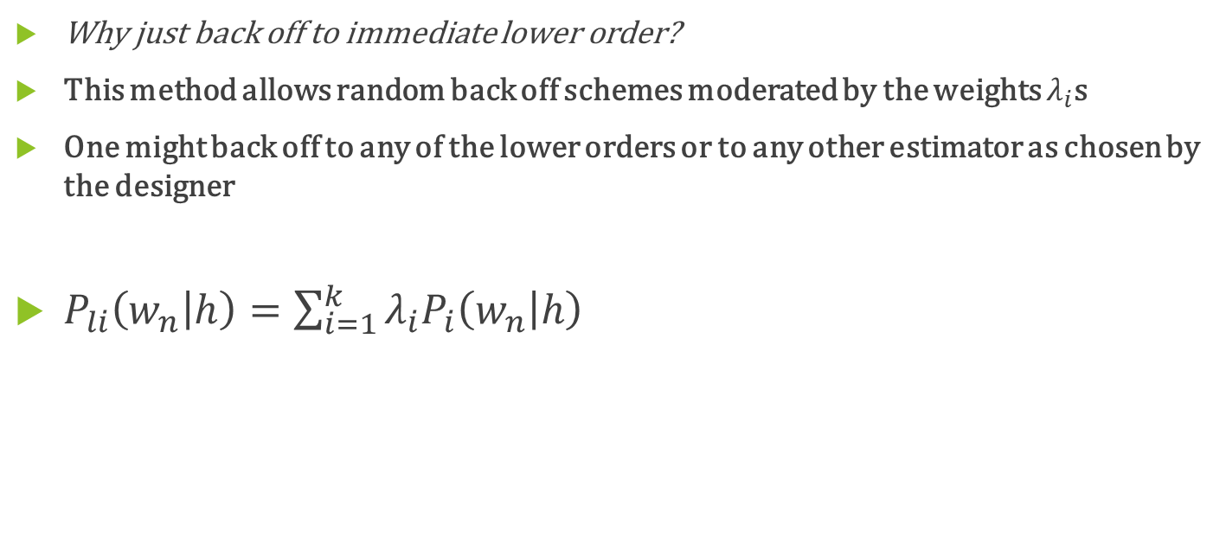
General Linear Interpolation
Why just back off to immediate lower order?
This method allows random back off schemes moderated by the weights $λ_{i}$s
One might back off to any of the lower orders or to any other estimator as chosen by the designer
$P_{li}\left(w_{n} | h\right)=\sum_{i=1}^{k}{λ_{i}P_{i}\left(w_{n} | h\right)}$

Slide 74
Witten Bell Smoothing
Where,

Slide 75
Sample Data
The boy ate a chocolate
The girl bought a chocolate
The girl then ate a chocolate
The boy bought a horse
The boy has a horse
The boy stole a chocolate
Compute likelihood of
The girl stole a horse

